Slide 1
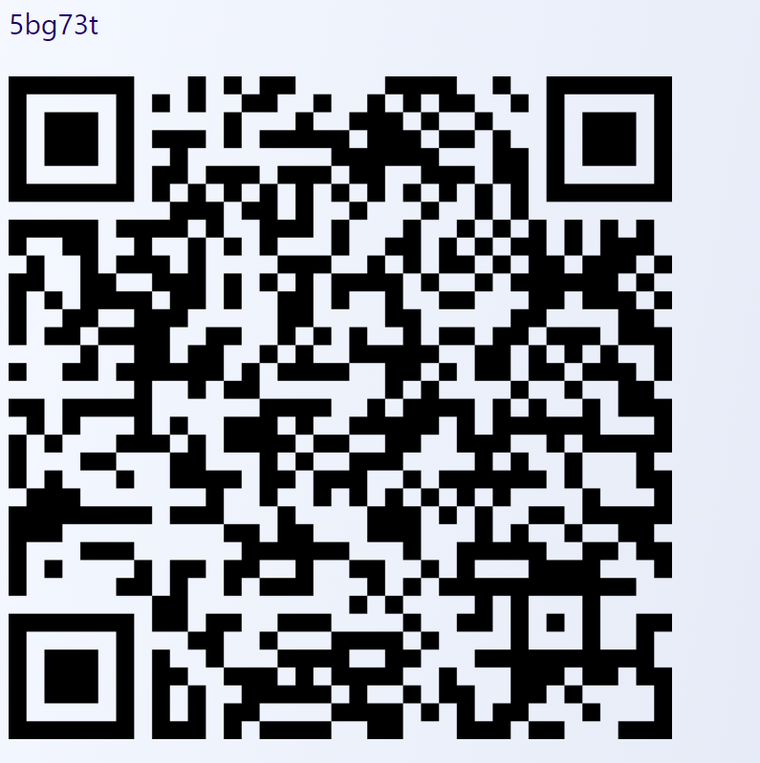
Attendance

Slide 2
Computer Organisation
Topic 5
Addressing, and Instruction Set Characteristics & Functions
Hamacher et al., Computer Organisation (5th Ed.), Chap. 2
Stallings, Computer Organization & Architecture (9th Ed.), Chap. 12
Notes:
We will be covering addressing, how the memories are being addressed,

Slide 3
Outline
Memory locations and addresses
Byte addressability
Big-endian and Little-endian Assignments
Memory operations
Instructions and instruction sequencing
Notation
Types of instruction
Types of operands
Types of operations
Notes:
We will look into how memory locations and addresses are being addressed, then how do we label the addresses,
Then we look at various memory locations, what kind of instructions associated with memories….
Then we look at instructions, how the instructions are being carried out especially in terms of the type of instructions the type of operand they use

Slide 4
Memory Locations
Operands and instructions are stored in memory
Notes:
Ok just like in your apartment or hostel, when you want to find somebody or go to a room, it has an address
Let say that you say I want to go to C-4-3, than you know, that you plan to go to block C, level 4 and unit 3….that’s how the apartment or hostel addressed….
So it similar to the address in memories but not physical labelled, but there is a memory assigned to each location
So basically this memory store the operand that are being used for the calculation, like all your variables, for example, like you say add A and B, so A and B are your operand.
This is actually store in memory first…besides operand, the memory also stored instructions
So whatever the processor needs to do, especially in terms of the processing and execution, all these materials comes from the memories
The processor is just like the oven, when you are baking, or when you cook, the processor is like the kuali, it act like a cooking device because in order for you to cook or in order for you to be able to use the cooking device, you need to get the materials from somewhere
Similary to processor, it takes the material from the memories

Slide 5
Memory Locations
Memory consists of many millions of storage cells
Each cell can store a “bit” with value 0 or 1
Each group of n bits is called a “word”
n = word length
Notes:
In memory it contains milliions of billions of storage cells
Storage cells means, just 1 bit, where it can be 0 or 1.
And a group of bit especially for example, in one memory location, the entire group of bits that is associated with that particular location is called a word….a memory word
Let say your memory has 2Gb location, and the architecture requires you to think in tems of 32 bits, so that 32 bits will be your word size

Slide 6
Memory Locations
n
bits
first word
second word
•
•
•
i
th word
•
•
•
last word
Memory words
Notes:
Roughly it looks like this…you have different locations…you see the first word, second word,
In this particular example, this word contain n bits
One thing to take note, when we draw this little diagram, we arranging the word on top of the other, this is just so that we human can visualize how the memory looks like
But in reality, it doesn’t look like this…so basically this is just a graphical representation so that we can imagine what goes on

Slide 7
Memory Locations
Many computers have word lengths from 16-64 bits
A unit of 8 bits = 1 “byte”
Notes:
Let say if your word length is 16 bits, so how many bytes? So it means 2 byes
So for the newer or modern computer architecture, they use 64 bits, so how many byte?
So 64 bits = 8 bytes
So don’t get confused yourself with the word, the bit and the bytes because these three are 3 different units use to quantify the number of bits

Slide 8
Memory Locations
Memory location contains
Instruction or Operand
Operand can be number/integer or character
Notes:
The other issue with memory location is that every location which mean every word will contain either instructions or operand,
So what can be an operand? Read slide

Slide 9
Memory Locations
32 bits
•
•
•
b
31
b
30
b
1
b
0
Sign bit:
b
31
=
0
for positive numbers
b
31
=
1
for negative numbers
(a) A signed integer
8 bits
8 bits
8 bits
8 bits
ASCII
ASCII
ASCII
ASCII
character
character
character
character
(b) Four characters
Examples of encoded information in a 32-bit word
Notes:
And there are also other kinds of things can be stored..and when it is stored, when this things are stored, they will be stored in different format
For example, if your memory word is storing an integer, and if you are using a 32-bit architecture, 32 bits words, so therefore your entire 32 bits will be used to stored that number
You can also imagine the magnitude of the number that you can stored
If it is a signed magnitude number, out of these 32 bits, the first bit will most likely be the sign bit and therefore you have 31 bits to express the magnitude
So what will be the largest number you can store? It will be 2 to the power of????? That one is for you to figure out
Ok that is for the integers…
So what if you want to store characters? Char you can stored in chunk of 8 bits
If you have 32 bit architecture, you can store 4 characters

Slide 10
Memory Locations
For instructions, memory word has fields for
Operation
Operand
8 bits
24 bits
Operation
Addressing information
field
00000000 – add
00000001 – write
Notes:
The memory locations also stored instructions.
For instructions, each word, each memory word will have a number of fields
One very obvious field will be the operation because it is instruction, right?
And this word is basically the operation. So what is the most important? The operation field and this example uses 8 bits which also indirectly means it can potentially 2 to the power of 8 operations that can be expressed.
For example, 0000000000 – can be mean add, 0000000001 can be mean write…..
Then, next remaining 24 bits will be the operand….if 8 bits has been used for the operation, 24 bits will be used for the operand….

Slide 11
Memory Locations
Accessing memory to store/retrieve requires addresses
Addresses expressed from 0 through 2^{k}-1
2^{k} addresses constitute the address space of the computer, 2^{k} addressable locations
Notes:
What about knowing what is where?
In order to access the memory to store materials or to retrieve materials, you need an address….. Just like for example, I want to find you, I need to know your address….and the addresses are expressed through the bit patterns…..from 0 to the 2k-1
The K here refers to the number of bits in your address….
In this case, you will have 2k addresses which then constitute the address space….that means when you want to locate something, you only have 2k unique identifier to pinpoint a location

Slide 12
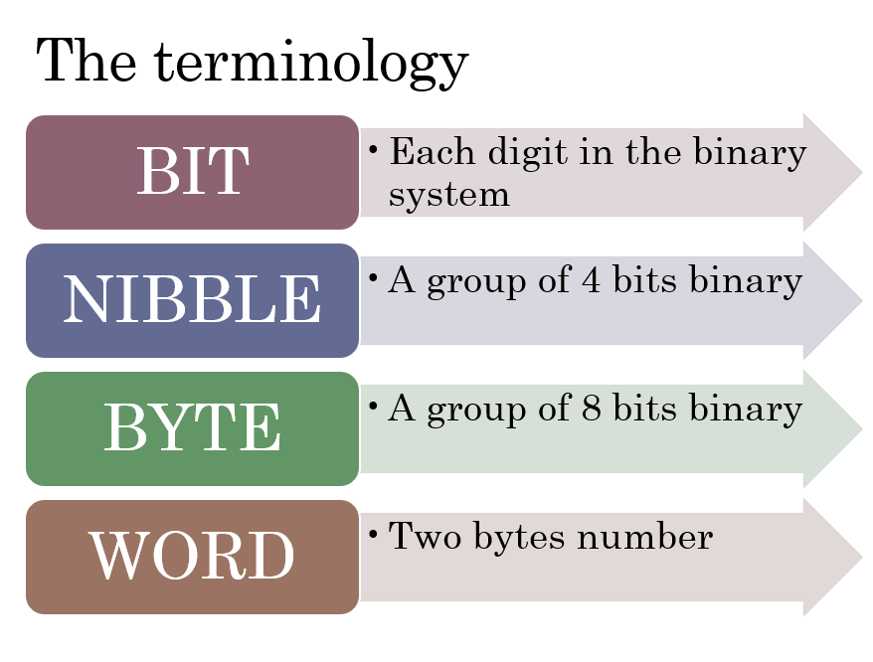
Byte Addressability
Not practical for each bit to have a memory address
Practical to have successive addresses for successive byte locations = byte addressability
Notes:
Okay let’s look at byte addressability…this is where the concept of 8 bit 1 byte that kind of things….
It is not practical for every room in an apartment having an identifier. So in the computer memory perspective, it is not practical to have each bit to have an address….it will be too many
SO the memory bits are organized in chunk….so in this case, every byes has an address, not every bit

Slide 13
Byte Addressability
Example
If byte location have addresses 0, 1, 2, …
If word length = 32 bits
Then successive words are located at addresses 0, 4, 8, … (each word 4 bytes)
32 bits
0
0
1
2
3
4
4
5
6
7
1 byte
1 byte
1 byte
1 byte
8
Notes:
32 bits = 4 bytes
So, the 0, 4, 8, 12, 16 are the address of the words
Assuming every word is 32 bits long, that mean every word is 4 bytes, that would also mean that the addresses of each word are in 4s.
Every word is 4 bytes

Slide 14
Quick Activity #1
What is the successive byte location for the following word length:
16 bits
64 bits
128 bits?
16 bits
64 bits
0 | 0 | 1
2 | 2 | 3
4 | 4 | 5
6 | 6 | 7
0 | 0 | 1 | 2 | 3 | 4 | 5 | 6 | 7
8 | 8 | 9 | 10 | 11 | 12 | 13 | 14 | 15
16 | 16 | 17 | 18 | 19 | 20 | 21 | 22 | 23
24

Slide 15
Byte Addressability
Address of each byte
Address
0
1
2
3
0
8 bits
8 bits
8 bits
8 bits
4
5
6
7
4
8 bits
8 bits
8 bits
8 bits
Address of each word
Notes:
4 bytes per word and every byte have an address…the address of each word will be multiply by 4
Notice the difference between the address of each byte and the address of each word
Every byte has an address and every word address is the multiple of the number of byte in that word

Slide 16
Big-endian and Little endian
Two ways that byte addresses can be assigned
Big-endian
When lower byte addresses are used for the more significant (leftmost) bytes
Little-endian
When lower byte addresses are used for the less significant (rightmost) bytes
Both are used in commercial machines
Notes:
The previous example of address labelling is what we called big-endian because the lower byte addresses are used for the more significant bytes (or the leftmost bytes)
Big-endian = smaller address for the lefter byte
BIG-ENDian = the bigger address at the end (at the end means on the right)
The reverse of that is little-endian, that’s mean the smaller byte address is at the end
Okay, which one used most often? Okay, most commercial machines used either one, there’s no real pros and cons or whatsoever

Slide 17
Big-endian and Little endian
W
ord
address
Byte address
Byte address
0
0
1
2
3
0
3
2
1
0
4
4
5
6
7
4
7
6
5
4
•
•
•
•
•
•
2
k
-
4
2
k
-
4
2
k
-
3
2
k
-
2
2
k
-
1
2
k
-
4
2
k
-
1
2
k
-
2
2
k
-
3
2
k
-
4
(a) Big-endian assignment
(b) Little-endian assignment
Byte and word addressing
Notes:
The BIG-endian is most appeal to English or Malay reader because we read from left to right
The LITTLE-endian is more appeal to the traditional Chinese writing, Arabic writing or Jawi writing, it’s from left to right
But the addressing of each word is the same the address of each word is the same
The for LITTLE-endian, the individual bytes are label the other way

Slide 18
Big-endian and Little endian
struct {
int a; //0x1112_1314
int pad; //
double b; //0x2122_2324_2526_2728
char* c; //0x3132_3334
char d[7]; //A,B,C,D,E,F,G
short e; //0x5152
int f; //0x6162_6364
} s;
Notes:
Let’s look at how Big-Endian and Little-Endian affect the storage. This is a simple and primitive program no worries whether its correct or not, the focus is the content we want to put in
For example
Variable a is an integer….it is a 4 byte integers
Then we have pad, pad is basically a blank storage,
Next we have double integer

Slide 19
Big-endian and Little endian
Int a;
Int pad;
Big-endian address mapping
Little-endian address mapping
Byte address
11
12
13
14
11
12
13
14
Byte address
00
00
01
02
03
04
05
06
07
07
06
05
04
03
02
01
00
00
21
22
23
24
25
26
27
28
21
22
23
24
25
26
27
28
08
08
09
0A
0B
0C
0D
0E
0F
0F
0E
0D
0C
0B
0A
09
08
08
31
32
33
34
A
B
C
D
D
C
B
A
31
32
33
34
10
10
11
12
13
14
15
16
17
17
16
15
14
13
12
11
10
10
E
F
G
51
52
51
52
G
F
E
18
18
19
1A
1B
1C
1D
1E
1F
1F
1E
1D
1C
1B
1A
19
18
18
61
62
63
64
61
62
63
64
20
20
21
22
23
23
22
21
20
20
Notes:
How those variable is stored…
Based on Big-endian address mapping, the integer a start storing from the lower addresses (it starts storing from the left), but for Little-endian it start storing from the right
Byte address 08 – double integer
Byte address 10 – storing char, (byte address 10 – 13 = storing the character) (byte address 14 – 17, storing character array – as individual element in the array

Slide 20
Word Alignment
Words are aligned when they begin at a byte address that is a multiple of the number of bytes
Number of bytes in a word is a power of 2
Example
If word length is 16 bits (2¹ bytes), aligned words begin at byte addresses 0, 2, 4, …
If word length is 32 bits (2² bytes), aligned words begin at byte addresses 0, 4, 8, …
Notes:
Word alignment correspond to how we label the addresses or rather how we label the words

Slide 21
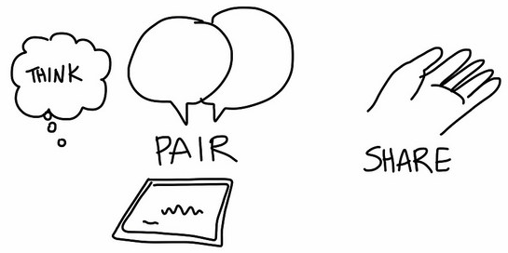
Word alignment
If word length is 64 bits (? bytes), aligned words begin at byte addresses ?, ?, ?, …

Slide 22
Outline
Memory locations and addresses
Byte addressability
Big-endian and Little-endian Assignments
Memory operations
Instructions and instruction sequencing
Notation
Types of instruction
Types of operands
Types of operations
Notes:
Just remember that your memory has location/address

Slide 23
Accessing Memory
Numbers/characters usually occupy 1 word
Notes:
So when you access memory, usually the word contain either number of character,

Slide 24
Accessing Memory
For character strings
Beginning of string indicated by giving byte address of first character
Successive byte locations contain successive characters of the string
End of string indicated by
Special control character to mean “end of string”
Separate memory word location or processor register to store number indicating string length
Notes:
And how do we access those content?
In terms of char strings, for example KIRAH, we need to know the address of the first character, which is K, and then, subsequently, successive byte locations that contain those character will then be read as well.
As for the end of string, it is a unique identifier to indicate the end of string…so when the computer read the string of character and encounter the unique identifier of end of string, it knows that it is the end of the string and will stop reading

Slide 25
Memory Operations
To execute instructions…
Word(s) containing instruction need to be transferred from memory to processor
Operands/results also need to be moved between memory and processor
Notes:
From the memory also, the processor will then know what instructions to execute. It means there are different things come from the memory….like numbers, characters and instructions
So in order to execute instructions, the word that contain instructions is taken from the memory to the processor.
Its like when you want to cook something, all the things will come from the fridge to the kuali

Slide 26
Memory Operations
Two basic operations:
Load (Read/Fetch)
Store (Write)
Notes:
And there are 2 basic operations in terms of what the memory does, it is load and storing
When load means that you are reading the operand, or your fetching operand from memory
Similary, you might reading or fetching instructions
The second one is storing, that means that after the processor have done the processing, we then store or your write the results back to memory

Slide 27
Memory Operations
Load
Processor sends address of memory location and requests content be read
Memory reads data at that address and sends to processor
Notes:
So what happens during loading? Loading means we take something from memory and load it to the processor, but how do we know what to do? Or rather where to get that materials from the memory?
So the processor actually need to send an address of the memory location and request the content.

Slide 28
Memory Operations
Store
Processor sends address of memory location with data to be written
Original content of memory at that location is destroyed
Notes:
The same process as previous operation, the processor needs to send an address of memory location but now together with the materials that need to be stored.
The address is very important so that the memory know where to fetch from and where to store to.

Slide 29
Memory Operations (Load)
Memory
Processor
Read request
+ address
Data
Notes:
So in terms of loading, it will looks like this, processor will send a read request and address of the materials, the memory will look for the data and return it to the processor

Slide 30
Memory Operations (Store)
Memory
Processor
Data
+ address
Notes:
In terms of storing, again the processor will send a data together with the address

Slide 31
What are other operations?
Notes:
Can you also name other operations aside from loading and storing?

Slide 32
Outline
Memory locations and addresses
Byte addressability
Big-endian and Little-endian Assignments
Memory operations
Instructions and instruction sequencing
Notation
Types of instruction
Types of operands
Types of operations
Notes:
Aside from memory operations, now let’s talk about instructions and instructions sequencing. So this is where some of the materials from the instructions

Slide 33
Instruction and Instruction Sequencing
Computers must have instructions capable of:
Data transfer between memory and processor (registers)
Load, Store, Push, Pop, etc.
Arithmetic and logic operations
ADD, SUB, MUL, DIV, AND, OR, XOR, etc.
Program sequencing and control
BR, SKP, CALL, etc.
I/O transfers
Test I/O, Halt I/O, Start I/O, etc.
Notes:
So, let’s talk about instructions and what they are capable of doing
SO computer in order to do its work, has to do 4 main things;
Data transfer - involve the transfer to and from memory/processor
Arithmetic – read slide
Sequencing and control – when a computer execute a program and then there is an IF statement, then you might need to do branching.
For IO transfers - the condition statement that need to be handled.

Slide 34
But first… some notation
Register Transfer Notation
Addresses of memory locations: e.g. LOC, VAR2, A
Processor registers: e.g. R0, R1
I/O registers: e.g. DATAIN, OUTSTATUS
Content of location denoted by square brackets
R1 ← [LOC]
R3 ← [R1] + [R2]
Notes:
We look into some notation first….
Addresses of memory, we can use LOC,VAR2, A…if you notice when you declaring a variable in programming, basically you are declaring an address
Processor register – when you want to specify a register,you also will specify an address
IO – read slides
Content of location
If you have a variable, you have a location, that is specified by the address, but when you refer to the content, the content of that address we usually put a bracket around it.
Without the bracket, we are referring to the address, with the bracket, we are referring to the content
For example,e for R1 and R2, we don’t want to add the address, but we want to add the content of that particular address

Slide 35
But first… some notation
Assembly Language Notation
To represent machine instructions
Move LOC,R1
Add R1,R2,R3

Slide 36
Outline
Memory locations and addresses
Byte addressability
Big-endian and Little-endian Assignments
Memory operations
Instructions and instruction sequencing
Notation
Types of instruction
Types of operands
Types of operations

Slide 37

Function
All computer functions are:
Data processing
Data storage
Data movement
Control
Source: https://www.flickr.com/photos/nubui/9550939064
Notes:
Lets rewind back the slides during our first lecture, we talk about the various functions

Slide 38
Instruction types
Different types of instructions are required to support high-level programming languages.
Notes:
There are various different type of instructions that are required to support your programming
The code that you write is the high level PL…

Slide 39
Instruction types
Data processing
Arithmetic instructions process numerical data.
Logic instructions operate on bits.
Notes:
Data processing is always arithmetic instructions that process numerical data and some of if will be logical to process the bits
For the arithmetic data, all those bits and byte you see represent numbers, floating points, integers,
All these numbers are important for you to do your addition, multiplication etc
But the computer not necessarily do numbers, it can also do logical operations…so the bit patterns is important, because when you do 1 and 1, it will be a 1, if you do 1 and 0, it will be a 0. So those are operating at the bit level, not necessarily at the numerical level.

Slide 40
Instruction types
Data storage (main memory)
Memory instructions move data between memory and registers.
Notes:
For data storage, it is basically moving data around especially between the memory and registers and the processor.

Slide 41
Instruction types
Data movement (I/O)
To transfer programs and data into memory, and results back to the user.
Notes:
This is actually more for IO, how does the processor communicate with other devices such as display devices or other input devices. w

Slide 42
Instruction types
Program flow control
Test instructions test the value of a data word or status of a computation.
Branch instructions divert the flow of the program to a different set of instructions depending on the decision made by the test instructions.
Notes:
Sometimes in the process of executing the programs, something happens.
Sometimes there might be a conditional statement, if statement, function call…. Or maybe sometimes the arithmetic operations will cause error, so the program flow control will handle those error

Slide 43
Attendance

Slide 44
Instruction types
Depends on how many addresses required in the instruction
3-address
2-address
1-address
0-address
8 bits
24 bits
Operation
Operand
Notes:
In terms of instructions type, there are also different ways in which each instructions can be expressed based on the numbers of addresses in the instructions.
Remember, in previous example, one field is reserved for the operation, and the remaining is the operand…..
How the 24 bits is organized?
SO based on instruction types, there are different ways of you to specify address in the instructions

Slide 45
Instruction types
Example:
C = A + B
Variable names = memory locations (addresses)
Variable values = content of memory location
C ← [A] + [B]
Notes:
A + B stored into C
How you read this instructions – we want to add the content of A and B and store it in the memory C location

Slide 46
Three-address Instruction
For C ← [A] + [B]
Requires 3 memory locations = 3 addresses
Add A,B,C
Operation Source1, Source2, Destination
operation
S1
S2
Destination
24 bits
Notes:
So your 24 bits is organized into 3 different field
Aside from the operation, there are 3 fields which contain 3 addresses

Slide 47
Three-address Instruction
Considered too large to fit in one word
Format
Operation
Source 1
Source 2
Destination
Notes:
However, 3-address instructions is considered too large

Slide 48
Three-address instruction
What are the consequences of having 3 addresses in one instruction (+ operation)?
Operation
Source 1
Source 2
Destination
8 bits
8 bits
8 bits
8 bits
Notes:
The processor will be a little slower…because processor need to look at 3 addresses
The number of memory…if you notice, for 32 bits memory, 8 has been used for operation, you left with only 24 bits which then need to be divided with 3 addresses, so the maximum address length is 8…so it cant accommodate any operand with more than 8 bit length

Slide 49
Write a program for the following function using three-address instructions:
Y = (A +B) * (C +D)
ADD R1, A, B
ADD R2, C, D
MUL Y, R1, R2
R1 ← M[A] + M [B]
R2 ← M[C] + M [D]
M[Y] ← R1 * R2

Slide 50
Two-address Instruction
Simplify C ← [A] + [B]
Consider B ← [A] + [B]
Requires 2 memory locations = 2 addresses
Add A,B
Operation Source, Destination
8 bits
operation
S1
Destination
24 bits
Notes:
How to overcome the 3-address issue, we have two-address instruction.

Slide 51
Two-address Instruction
Original C ← [A] + [B] can still be accomplished
Move B,C
Add A,C
2-address sometimes still too long
Format
[Move B to C]
[Add A to C]
Operation
Source
Destination
8 bits

Slide 52
Write a program for the following function using two-address instructions:
Y = (A +B) * (C +D)
MOV R1, A
ADD R1, B
MOV R2, C
ADD R2, D
MUL R1, R2
MOV Y, R1
R1 ← M[A]
R1 ← R1 + M[B] – Perform A + B
R2 ← M[C]
R1 ← R2 + M[D] – Perform C + D
R1 ← R1 * R2 (Perform (A+B) * (C +D))
M[Y] ← R1

Slide 53
One-address Instruction
When more than one operand is needed, the location of the other operand is implicit = accumulator (a processor register)
Notes:
Processor register called accumulator and stores the sum back into the accumulator destroying the previous content of the accumulator

Slide 54
One-address Instruction
Requires Load and Store (1-address) instructions
C ← [A] + [B]
Load A (to accumulator)
Add B (to accumulator)
Store C (from accumulator)
Format
[Copy content of memory location A into accumulator]
[Add the content of A into the accumulator]
[Store accumulator value to C register]
Operation
Source/Destination
Notes:
LOAD A – you just need the address of A only
Next instruction is to ADD B to A (which the value of A has been stored in A)
Next, to store C – which mean you need to store whatever value in the Accumulator in C
So for 1-address instruction, you just need to call one address because the other address are already in the acummulator

Slide 55
One-address instruction
What are the consequences of having 1 address in one instruction?

Slide 56
Zero-address Instruction and the Stack
Uses the stack structure
Addresses are implied
Stack pointer
Notes:
If 1 address is considered too long, now let’s look at 0 address instructions
It involve data structure which called a stack
Stack in data structure is that you stack things…which means when you have new things, it will goes on top
If you want to remove, you will remove from the top also
Imagine a pile of trays at Ikea, customers pick up new trays from the top of the pile, and clean trays are added to the pile by placing them onto the top of the pile
For stack, the address is implied…just now in 1-address instruction, you have accumulator, right? The accumulator is implied, but you still need to specify the address, what to do with the accumulator.
In this case, even the address is implied because the address of those operand, the address of those A B and C, are automatically maintained by a stack pointer
For example, if we have a new data to be put in, the stack pointer will point to the one that you put on the top…stack pointer is move by itself and that is why it always implied
The good thing is that you don’t have to know the exact address

Slide 57
Stack
List of data elements (words/bytes) with accessing restrictions
Elements added/removed at one end only – top of the stack (other end is bottom)
LIFO (last in first out)

Slide 58
Stack
Push: place new item on the stack
Pop: remove top item from the stack
Notes:
These are the two instructions on how we operate the stack
PUSH - place new item on the stack – so the stack pointer will be pointing to the new item
POP – remove top item from the stack – remove whatever that is pointed by the stack pointer

Slide 59
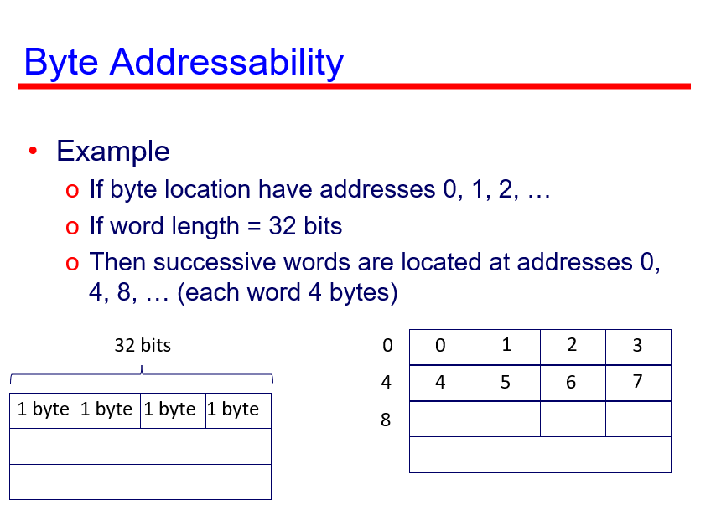
Stack
Assume first element placed in location BOTTOM
New elements pushed onto successively lower addresses
Stack grows in direction of decreasing memory addresses
Stack pointer (SP) used to keep track of the address of the element at the top of the stack
Notes:
The one at the bottom is always at the bottom and the bottom is actually the address
In earlier slide, the address start with the lowest bit ; 0, 4, 8 and so on……That is what it means by new elements pushed onto successively lower addresses

Slide 60
Stack
0
Stack
•
•
•
pointer
register
SP
-
28
Current
top element
17
739
Stack
•
•
•
BOTTOM
43
Bottom
element
•
•
•
2
k
-
1
A stack of words in the memory

Slide 61
Stack
Push
Subtract #4,SP
Move NEWITEM,(SP)
Pop
Move (SP),ITEM
Add #4,SP
SP
19
-
28
SP
-
28
-
28
17
17
739
739
Stack
43
43
NEWITEM
19
ITEM
-
28
After push from NEWITEM
After pop into ITEM
Notes:
PUSH
You subtract 4 from the stack pointer and you the new item to the stack pointer
When you push, the stack pointer will move up and point to the top of the item
POP
When you pop. You will see that the stack pointer move down…which mean the SP address will get larger

Slide 62
Example: n-address instructions on PowerPC
Y = (A – B) / (C + D * E)
3-address instruction
 |  | COMMENT
SUB | Y, A, B | Y← A – B
MPY | T, D, E | T← D * E
ADD | T, T, C | T← T + C
DIV | Y, Y, T | Y ← Y / T
2-address instruction
 |  | COMMENT
MOVE | Y, A | Y← A
SUB | Y, B | Y← Y – B
MOVE | T, D | T← D
MPY | T, E | T← T * E
ADD | T, C | T← T + C
DIV | Y, T | Y←Y / T
Note different ordering of source/destination

Slide 63
Example: n-address instructions on PowerPC
0-address instruction
=> Using stack
PUSH | A
PUSH | B
SUB |  | A-B
PUSH | C
PUSH | D
PUSH | E
MUL |  | D*E
ADD |  | (C+D*E)
DIV |  | (A-B)/(C+D*E)
POP Y
Y = (A – B) / (C + D * E)
1-address instruction
 |  | COMMENT
LOAD | D | AC← D
MPY | E | AC← AC * E
ADD | C | AC← AC + C
STOR | Y | Y← AC
LOAD | A | AC←A
SUB | B | AC← AC – B
DIV | Y | AC← AC / Y
STOR | Y | Y← AC
Note different ordering of source/destination

Slide 64
Example: n-address instructions on PowerPC
PEMDAS
Y = (A – B) / (C + D * E)
top | A
top | B
 | A
top | A - B
top | C
 | A - B
top | D
 | C
 | A - B
PUSH A
PUSH B
SUB
PUSH C
PUSH D
top | E
 | D
 | C
 | A - B
top | D * E
 | C
 | A - B
top | C + D * E
 | A - B
top | (A – B) / (C + D * E)
MUL
ADD
DIV
PUSH E
Notes:
Parentheses
Exponent
Multiplication
Division
Addition
Subtraction

Slide 65
Instruction | Stack
PUSH A | A
PUSH B | B
SUB | (A-B)
PUSH C | C
PUSH D | D
PUSH E | E
MUL | (D*E)
ADD | (C + D * E)
DIV | (A – B) / (C + D * E)
POP Y
Y = (A – B) / (C + D * E)

Slide 66
Queue
A data structure
FIFO (first in first out)
Assume queue grows in direction of increasing memory addresses
New data added at the back (high-memory address)
Retrieved from the front (low-address end)

Slide 67
Queue
Difference between queue and stack
One end of stack is fixed (bottom), one pointer for top of stack
Both ends of queue move to higher addresses, two pointers for both ends

Slide 68
3, 2, 1, 0-address instruction
Which would you prefer?

Slide 69
How Many Addresses
More addresses
More complex (powerful?) instructions
More registers
Inter-register operations are quicker
Fewer instructions per program

Slide 70
How Many Addresses
Fewer addresses
Less complex (powerful?), more primitive instructions
More (but shorter) instructions per program
Faster fetch/execution of instructions

Slide 71
Design Decisions
Operation repertoire
How many ops?
What can they do?
How complex are they?
Data types
Instruction formats
Length of op code field
Number of addresses

Slide 72
Design Decisions
Registers
Number of CPU registers available
Which operations can be performed on which registers?
Addressing modes (later…)

Slide 73
Outline
Memory locations and addresses
Byte addressability
Big-endian and Little-endian Assignments
Memory operations
Instructions and instruction sequencing
Notation
Types of instruction
Types of operands
Types of operations

Slide 74
Types of Operand
Machine instructions operate on data (the operand).
General categories of data are:
Addresses
A form of data.
Sometimes, calculations are performed on addresses.
Can be considered unsigned integers.

Slide 75
Types of Operand
Machine instructions operate on data (the operand).
General categories of data are:
Numbers
Integer/floating point/decimal
Packed decimal useful for simple decimal computation (0=0000, 1=0001, 2=0010, …, 9=1001)

Slide 76
Types of Operand
Machine instructions operate on data (the operand).
General categories of data are:
Characters
ASCII (7-bit pattern = 128 different characters)
EBCDIC (8-bit code)

Slide 77
Types of Operand
Machine instructions operate on data (the operand).
General categories of data are:
Logical Data
Bits or flags

Slide 78
Outline
Memory locations and addresses
Byte addressability
Big-endian and Little-endian Assignments
Memory operations
Instructions and instruction sequencing
Notation
Types of instruction
Types of operands
Types of operations

Slide 79
Types of Operation
Data Transfer
Arithmetic
Logical
Conversion
I/O
System Control
Transfer of Control

Slide 80
Data Transfer
Move, Store, Load, Exchange, Clear, Set, Push, Pop
Specify
Source & destination (e.g. memory, register, stack, etc.)
Amount (length) of data
Addressing mode

Slide 81
Data Transfer
May be different instructions for different movements (between register/memory)
e.g. IBM 370
Or one instruction and different addresses
e.g. VAX

Slide 82
Data Transfer
Data transfer operations is perhaps simplest for CPU:
e.g. if source and destination are registers, CPU causes data to be transferred between registers

Slide 83
Data Transfer
Data transfer operations is perhaps simplest for CPU:
e.g. if one or both operands are in memory:
Calculate memory address based on address mode
If address in virtual memory, translate virtual to actual address
Determine address item is in cache
If not, issue command to memory module

Slide 84
Arithmetic
Add, Subtract, Multiply, Divide, Absolute, etc.
For signed integer (fixed-point) numbers
Often also for floating point numbers
May include single-operand instructions:
Absolute (|a|)
Increment (a++)
Decrement (a--)
Negate (-a)
Involves the ALU

Slide 85
Logical
Bitwise operations
AND, OR, NOT, XOR, EQUAL
Logical Shifts
Bits shifted to left or right
Bit shifted out is lost; at other end, 0 shifted in
0
• • •
Logical right shift
0
• • •
Logical left shift

Slide 86
Logical
Useful to transmitting characters to IO device:
e.g. for 16 bit word containing 2 characters
Load word into register
Shift right eight times (shifts remaining characters to right half of register)
Perform IO (IO module read lower-order 8 bits from bus)
This is the LEFT character
Then load words again
AND with 0000000011111111 (masks out character on the left)
Perform IO for second character
This is the RIGHT character

Slide 87
Logical
Arithmetic Shifts
Does not shift sign bit (sign bit is replicated to right or left)
• • •
Arithmetic right shift
• • •
Arithmetic left shift

Slide 88
Logical
Still remember this?!?
When do you shift right or left?
Arithmetic Shifts
Does not shift sign bit (sign bit is replicated to right or left)
• • •
Arithmetic right shift
• • •
Arithmetic left shift

Slide 89
Logical
Rotate (cyclic shift)
• • •
Rotate right
• • •
Rotate left

Slide 90
Conversion
Operations that change the format or operate on the format of data.
E.g. Binary to Decimal

Slide 91
Input/Output
May be specific instructions
May be done using data movement instructions (memory mapped)
May be done by a separate controller (DMA)

Slide 92
Systems Control
Privileged instructions
CPU needs to be in specific state (or program executing in a privileged area of memory)
Ring 0 on 80386+
Kernel mode
For operating systems use

Slide 93
Transfer of Control
Transfer of control operations are required to:
execute instructions more than once
incorporate decision making
allow programs to be broken up into smaller pieces
Notes:
Transfer of control is basically your condition processing…when you write your program, sometimes you have if statement, else statement, so certain decision has to be made a certain point in your program….

Slide 94
Transfer of Control
Examples of transfer of control operations:
Branch
Skip
Procedure call
Program counter is updated to contain the address of some instruction in memory

Slide 95
Transfer of Control
Branch (or jump)
e.g. branch to x if result is zero (conditional branch)
Skip (typically with implied address)
e.g. increment and skip if zero
Procedure or Subroutine call
involves a Call instruction from present location to the procedure and a Return instruction from the procedure back to the location from which it was called
can involve the use of a stack to keep track of addresses

Slide 96
Which data structure can monitor/keep track of procedure/subroutine calls?
A
B
C
D

Slide 97
Transfer of Control
Use of stack to implement nested subroutines (to keep track of return address)
Return
Address
4601
4651
4101
4101
4101
4101
4101
•
•
•
•
•
•
•
Initial
After
CALL
Proc 1
After
CALL
Proc 2
After
RETURN
After
CALL
Proc 2
After
RETURN
After
RETURN

Slide 98
Straight-line Sequencing
How is program executed
Program counter (PC) holds address of instruction to be executed next
To begin, address of first instruction must be placed in PC
Processor uses information in PC to fetch and execute instructions
During execution of each instruction, PC incremented (e.g. + 4) to point to next instruction

Slide 99
Straight-line Sequencing
Instruction execution in 2 phases:
Phase 1: Fetch
Fetch instruction based on content of program counter (PC)
Fetched instruction placed in instruction register (IR)
Phase 2: Execution
Content of IR examined to determine which operation to perform
Involves fetching operands, performing an arithmetic/logic operation and storing results
Notes:
When you do straight line sequencing, it probably involve 2 steps….
Phase 1:FETCH
fetch the instructions pointed by the program counter because PC is a special register in the CPU and PC always contain the address of next instructions. So we see that address in the pC, and then we fetch that address from memory.
When we look on the address, we look at the CONTENT of an address
PC – contain an address
IR – contain an instruction that has been fetched
After instruction has been fetched, been stored in the IR, then comes the execution
Content of IR will be examined to determine the operation – where is the opcode and where is the operand

Slide 100
Straight-line Sequencing
Address
Contents
Begin execution here
i
Move
A,R0
3-instruction
i
+ 4
Add
B,R0
program
segment
i
+ 8
Move
R0,C
A
B
Data for
the program
Assume
Word length = 32 bits
Each instruction = 4 bytes
C
Program for C ← [A] + [B]

Slide 101
Branching
Instead of using the sequential (incremented from earlier instruction) content of PC, a new value is loaded into the PC
Processor fetches and executes instruction at new address (branch target)
Notes:
What happens in branching? Like I mentioned to you, sometimes when you execute your instructions, it is not in sequential manner….

Slide 102
Branching
If a condition needs to be met before causing a branch, it is called a conditional branch
Example
Add n numbers (NUM1, NUM2, … NUMn) using conditional branch by checking a control variable stored in R1
Notes:
One example is conditional branching and you only do the branching only when certain condition of branching are met.

Slide 103
Branching
i
Move
NUM1,R0
Program
i
+
4
Add
NUM2,R0
Collect all number to R0
i
+
8
Add
NUM3,R0
•
•
•
i
+
4
n
-
4
Add
NUM
n
,R0
i
+
4
n
Move
R0,SUM
•
•
•
SUM
NUM1
Data
NUM2
•
•
•
NUM
n
A straight-line program for adding n numbers

Slide 104
Branching
Move
N,R1
Clear
R0
LOOP
Determine address of
"Next" number and add
Addition happens here
Program
"Next" number to R0
loop
Decrement
R1
Branch>0
LOOP
Move
R0,SUM
•
•
•
SUM
N
n
NUM1
NUM2
•
•
•
NUM
n
Using a loop to add n numbers
Notes:
R1 will be collector of all number
R1 is also act as your counter

Slide 105
No branching vs branching
i
Move
NUM1,R0
Move
N,R1
i
+
4
Add
NUM2,R0
Clear
R0
i
+
8
Add
NUM3,R0
LOOP
Determine address of
•
•
•
"Next" number and add
Program
"Next" number to R0
loop
Decrement
R1
i
+
4
n
-
4
Add
NUM
n
,R0
Branch>0
LOOP
i
+
4
n
Move
R0,SUM
Move
R0,SUM
•
•
•
•
•
•
SUM
SUM
NUM1
N
n
NUM2
NUM1
•
•
•
NUM2
•
•
•
NUM
n
NUM
n
Notes:
What is the difference ?
Main difference is the program

Slide 106
Condition Codes
Processor keeps track of information about the results of various operations
Recorded as bits called condition code flags
Stored in condition register or status register

Slide 107
Condition Codes
Common flags
N (negative): 1 if result is –ve
Z (zero): 1 if result is zero
V (overflow): 1 if arithmetic overflow occurs
C (carry): if carry-out results from the operation
Branches may be conditional branches

Slide 108

Reflection…
From the lecture today,
I learnt…
Link on eLearn / Chat
Image source: https://www.flickr.com/photos/29143375@N05/4582236533

